Slide 1

Log Analysis: Using ELK Stack
Sanskar Dwivedi

Slide 2
Why Log Analysis?
- In cloud-based environment infrastructures, performance, and isolation is very important. The performance of virtual machines in the cloud may vary based on the specific loads, environments, and number of active users in the system. Therefore, reliability and node failure can become a significant issue.
- Log management platform can monitor all above-given issues as well as process operating system logs, NGINX, IIS server log for web traffic analysis, application logs, and logs on AWS (Amazon web services).
Log management helps DevOps engineers, system admin to make better business decisions. Hence, log analysis via Elastic Stack or similar tools is important.

Slide 3
Log Analysis: Advantages
Reduces problem diagnosis & resolution time: Hunting down issues can be a tedious and time-wasting task, especially when it’s not clear if the problem is on the application layer or infrastructure. Whether it’s one or the other, or a combination of the two, they prolong the time your app delivers a poor user experience. Log file analysis allows you to take a proactive approach by pointing out issues and their root causes before or as they happen. This avoids time loss and reduces MTTR (Mean Time To Recover). Hence, Log Analysis shortens the time a business needs to detect and solve production problems and allow teams to focus more on improving existing and adding new functionalities to products and services they are creating instead of spending time troubleshooting. This, in turn, increases the value of software they are building, leads to more frequent releases, and increases the overall value for the business.

Slide 4
Log Analysis: Advantages
Reduces Customer Churn: Customers are more selective than ever when it comes to the applications they use. With such a large pool of alternatives at their disposal, they can easily turn to one of your competitors if they’re not satisfied with your product or service. You must deliver an excellent user experience that, looking beyond functionalities, boils down to a stable and performant application with regular updates. Frequent downtimes and poor product quality are among the top reasons for high customer churn. By analyzing your log files, you can detect the root cause of performance and stability issues faster, thus improving your users’ experience and reducing customer churn. For example, you’ll be able to search for HTTP errors and understand where and why they occurred; or detect when users don’t receive the information they searched for or if their requests are taking too long to load, or if some microservices are experiencing issues, and so on.

Slide 5
Log Analysis: Advantages
Improve Resource Usage & Production Infrastructure Costs: One of the most challenging aspects of any organization is resource management – from network bandwidth to CPU cycles or storage capacity and beyond. You can speculate resource sizing, but you either end with not enough resources – which leads to poor performance, frustrated customers, and, ultimately, lost sales – or too many – which increase expenses, thus affecting your bottom line. Instead of guessing your resource requirements, log file analysis – along with metrics-based resource usage and planning – allows you to easily and more accurately understand your current resource utilization and your future resource requirements. Also, when it comes to system performance, more often than not, it’s not the software at fault, but rather users’ requests that overload your system to the point where it has trouble handling the demand. Log analysis allows you to track resource usage and detect where your system is struggling so that you can add extra capacity. On the other hand, you can also see underutilized or dead assets so that you can restructure and optimize your infrastructure to improve productivity and proficiency. You can also use server-sprawl data to optimize your on-premise or cloud infrastructure costs.

Slide 6
Log Analysis: How does it work?
- Logs are streams of chronologically arranged messages generated by applications, network devices, operating systems, and any programmable or smart device.
- When analyzed, they can provide a wealth of information about the components in your stack and how they interact. Here’s how you can perform log analysis the proper way:
Collect – set up a log collector to gather all the logs across your infrastructure
Centralize and index – ship the logs to a centralized logging platform. It’s easier to query and analyze logs from a single pane of glass. When collected to the central location, logs are also normalized to a common format to avoid confusion and ensure uniformity. Along with indexing, it makes data readily available and searchable for efficient log analysis
Search and analyze – you can search for logs matching various patterns, and structures. For example, logs with a specific exception or severity level. Analyzing logs via reports and dashboards make information available for everyone including people outside the IT department. Not to mention, of course, that it’s easier to spot trends or anomalies by looking at graphs or other visual representations of your data.
Monitor and alert – set up alerts to notify you in real-time when certain conditions are not met. This helps detect what happened, when, where, why, and how it impacted performance, enabling you to build appropriate countermeasures and models to avoid risks. Alerts may also have triggers, such as calling a webhook to restart a service.

Slide 7
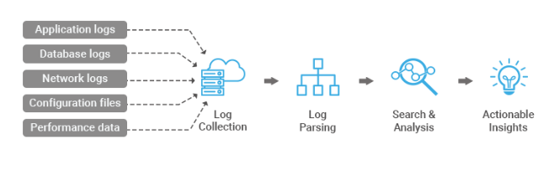
Log Analysis: Process

Slide 8

Why use ELK ?
PROBLEMS: - Multiple data centers, ten of thousands of servers, hundreds of billions of log records - Logging, indexing, searching, visualizing and analysing all of those logs all day every day - Security (access control, storage, transport) - Scaling to more DCs, more servers, and even more logs... - ARRGGGGHHH!!!!!
SOLUTIONS: • Commercial Splunk, Sumo Logic, HP ArcSight Logger, Tibco, XpoLog, Loggly, etc. • Open Source Syslog + Grep, Graylog, Elasticsearch, etc.

Slide 9
Case Studies
Netflix
Netflix heavily relies on ELK stack. The company is using ELK stack to monitor and analyze customer service operation’s security log. It allows them to index, store, and search documents from more than fifteen clusters which comprise almost 800 nodes.
LinkedIn
The famous social media marketing site LinkedIn uses ELK stack to monitor performance and security. The IT team integrated ELK with Kafka to support their load in real time. Their ELK operation includes more than 100 clusters across six different data centers.
Tripwire
Tripwire is a worldwide Security Information Event Management system. The company uses ELK to support information packet log analysis.
Medium
Medium is a famous blog-publishing platform. They use ELK stack to debug their production issues(Just like Amdocs). The company also uses ELK to detect DynamoDB hotpots. Moreover, using this stack, the company can support 25 million unique readers as well as thousands of published posts each week.

Slide 10
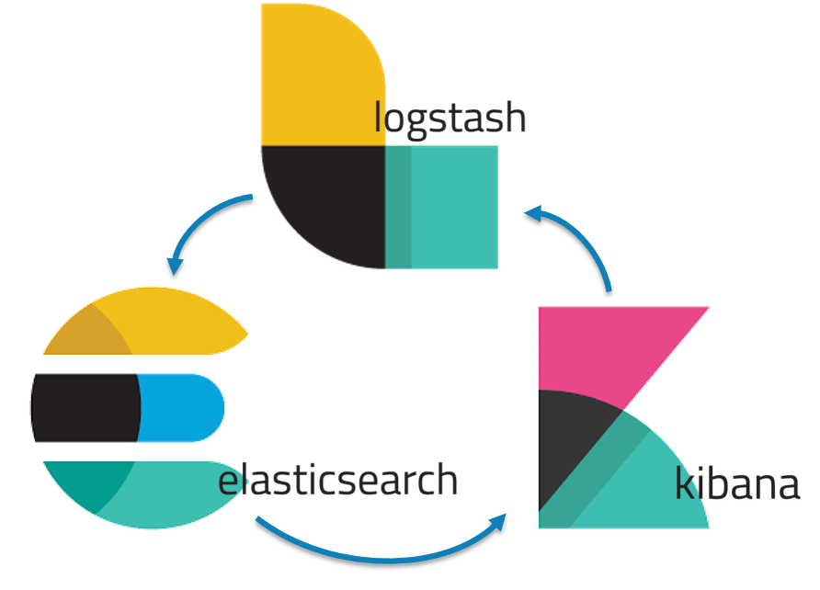
What is ELK Stack?
The ELK Stack is a collection of three open-source products — Elasticsearch, Logstash, and Kibana.
ELK stack provides centralized logging in order to identify problems with servers or applications.
Allows you to search all the logs in a single place.
Also helps to find issues in multiple servers by connecting logs during a specific time frame.
E stands for ElasticSearch: used for storing logs
L stands for LogStash : used for both shipping as well as processing and storing logs
K stands for Kibana: is a visualization tool (a web interface) which is hosted through Nginx or Apache
ElasticSearch, LogStash and Kibana are all developed, managed ,and maintained by the company named Elastic.
ELK Stack is designed to allow users to take data from any source, in any format, and to search, analyze, and visualize that data in real time.

Slide 11
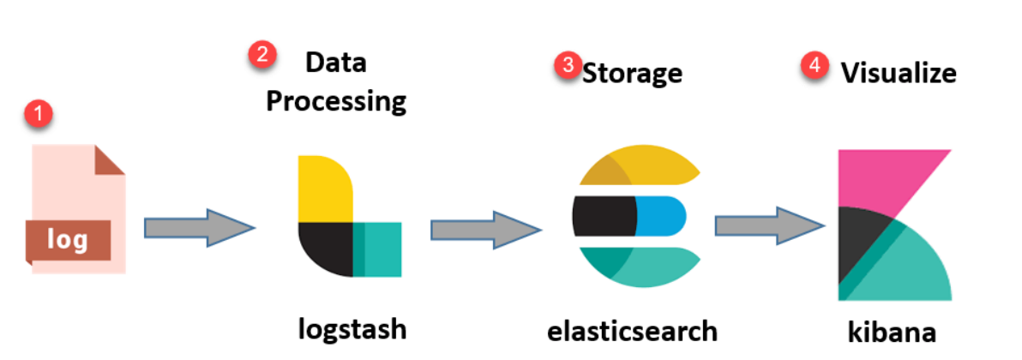
ELK Stack: Architecture
- Simple Architecture of ELK Stack :
Logs: Server logs that needs to be analyzed are identified.
Logstash: Collect logs and events data. It even parses and transforms data.
ElasticSearch: The transformed data from Logstash is Stored, Searched, and Indexed.
Kibana: Kibana uses Elasticsearch DB to Explore, Visualize, and Share.

Slide 12
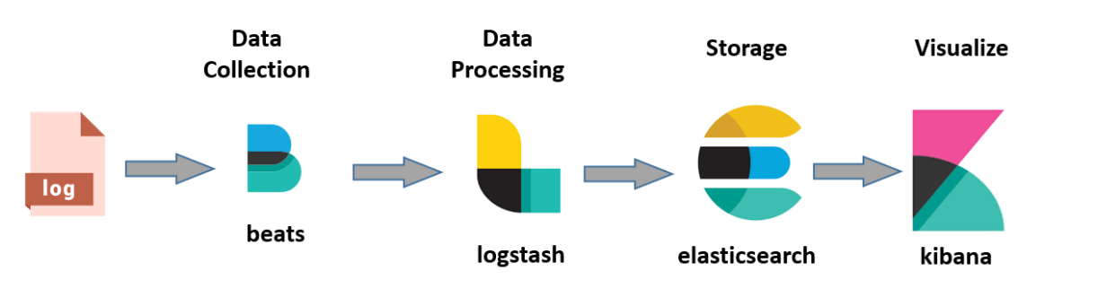
However, one more component is needed, or Data collection called Beats. This led Elastic to rename ELK as the Elastic Stack. (Beats is a simple data shipper that either sits on servers or on containers, that listen to log file locations and ship them to either Logstash for transformation or Elasticsearch.)

Slide 13
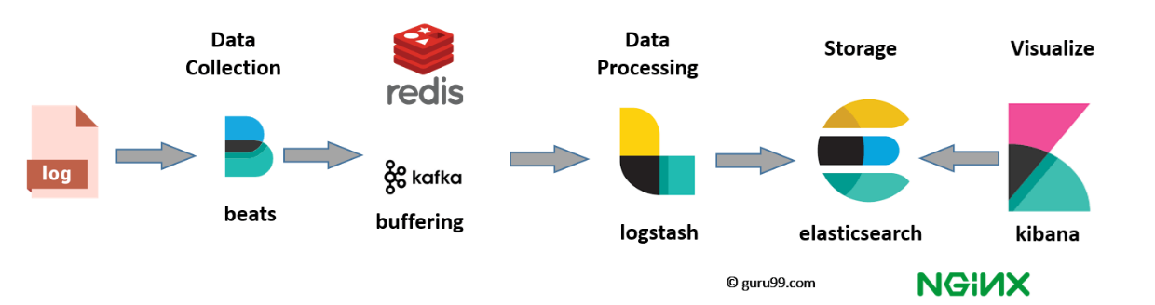
While dealing with very large amounts of data, you may need Kafka, RabbitMQ for buffering and resilience. For security, nginx can be used.

Slide 14
What is Elasticsearch?
A NoSQL database.
Based on Lucene search engine, and it is built with RESTful APIS.
Offers simple deployment, maximum reliability, and easy management.
Also offers advanced queries to perform detail analysis and stores all the data centrally.
Helpful for executing a quick search of the documents.
Allows you to store, search and analyze big volume of data.
Mostly used as the underlying engine to powers applications that completed search requirements.
It has been adopted in search engine platforms for modern web and mobile applications.
Apart from a quick search, the tool also offers complex analytics and many advanced features.

Slide 15
ElasticSearch: Features
Open-source search server is written using Java (since based on Apache Lucene).
Used to index any kind of heterogeneous data (indexing makes searching easier).
Has REST API web-interface with JSON output.
Full-Text Search.
Near Real Time (NRT) search.
Sharded, replicated searchable, JSON document store. (Shards are horizontal partition of data in a database or search engine. Each shard is held on a separate database server instance, to spread load.)
Schema-free, REST & JSON based distributed document store
Multi-language & Geolocation support.

Slide 16
ElasticSearch: Advantages
Store schema-less data and creates a schema for your data.
Manipulate your data record by record with the help of Multi-document APIs.
Perform filtering and querying your data for insights.
Based on Apache Lucene and provides RESTful API.
Provides horizontal scalability, reliability, and multitenant capability for real time use of indexing to make it faster search.
Helps you to scale vertically and horizontally.

Slide 17
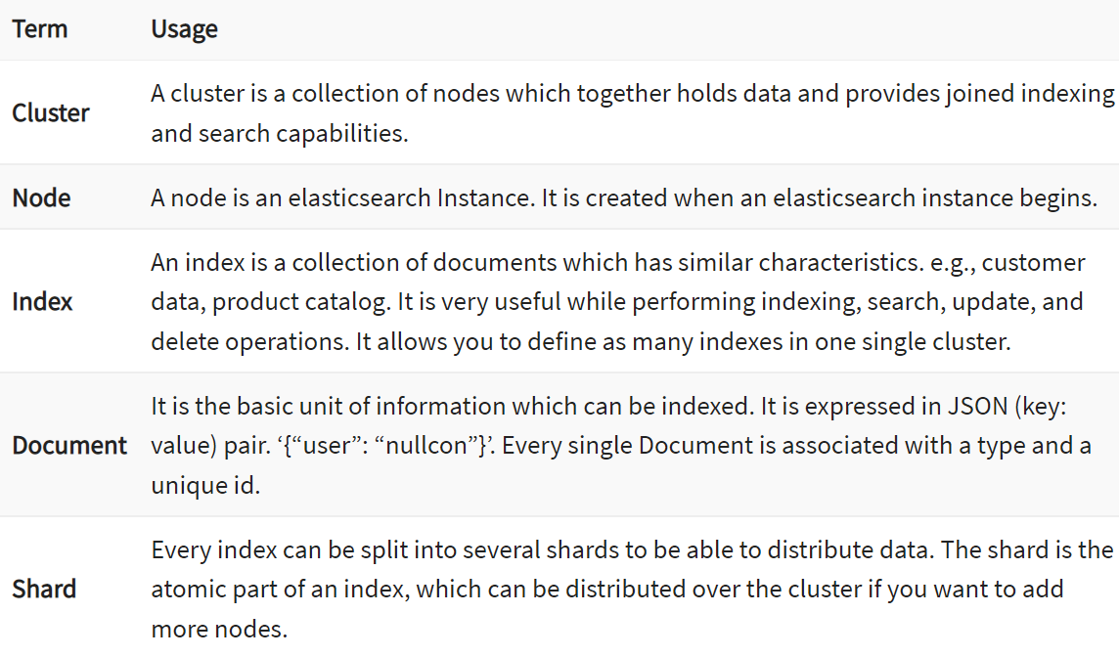
Elasticsearch: Important Terms

Slide 18
What is Logstash?
- Logstash is the data collection pipeline tool. It collects data inputs and feeds into the Elasticsearch.
- It gathers all types of data from the different source and makes it available for further use.
Logstash can unify data from disparate sources and normalize the data into your desired destinations.
It allows you to cleanse and democratize all your data for analytics and visualization of use cases.
It consists of three components:
Input: passing logs to process them into machine understandable format
Filters: It is a set of conditions to perform a particular action or event
Output: Decision maker for processed event or log

Slide 19
Logstash: Features
Events are passed through each phase using internal queues
Allows different inputs for your logs
Filtering/parsing for your logs

Slide 20
Logstash: Advantages
Offers centralizing the data processing.
It analyzes a large variety of structured/unstructured data and events.
ELK LogStash offers plugins to connect with various types of input sources and platforms.

Slide 21
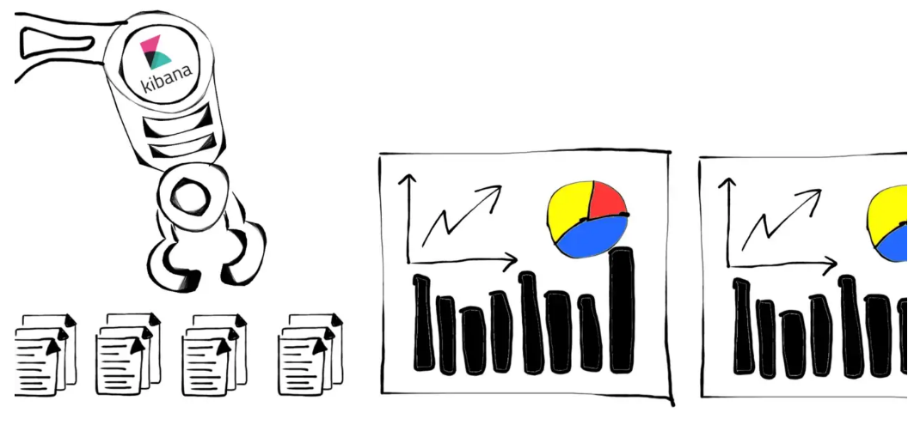
Kibana: Introduction (Our main topic for session)
Kibana is a data visualizer tool of ELK.
Kibana is an exploration and visualization tool. You can use it to analyze elastic search’s logs or time series data and monitor the specific application.
Kibana isn’t the only tool to visualize elastic search results. There are many other tools, like as Grafana and others.
Different from Grafana, Kibana needs to rely on the elastic search service. By default, it will listen to the elastic search service on port 9200 and start the service on port 5601.(Of course, like as elastic search, you can customize these configuration at specific yaml file.)

Slide 22
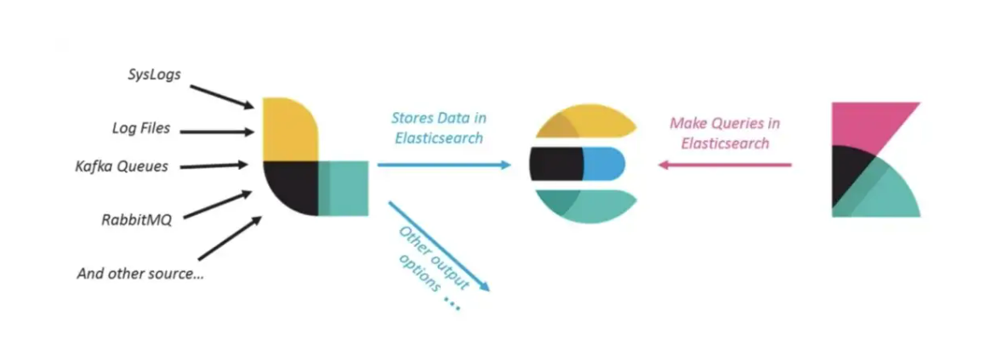
Kibana: Role in ELK Stack

Slide 23
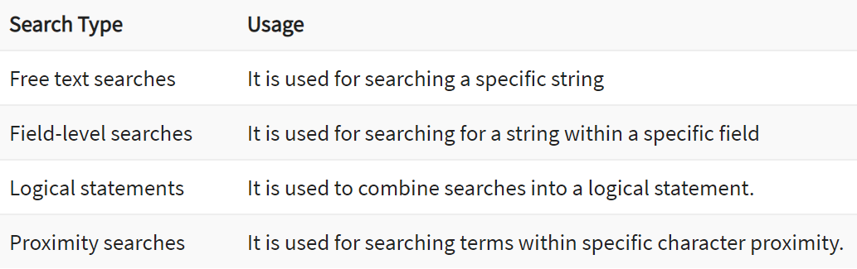
What is Kibana?
Kibana is a data visualization tool which completes the ELK stack. This tool is used for visualizing the Elasticsearch documents and helps developers to have a quick insight into it.
Kibana dashboard offers various interactive diagrams, geospatial data, and graphs to visualize complex queries.
It can be used for searching, viewing, and interacting with data stored in Elasticsearch directories.
Kibana helps you to perform advanced data analysis and visualize your data in a variety of tables, charts, and maps.
In Kibana there are different methods for performing searches on your data. Here are the most common search types:

Slide 24
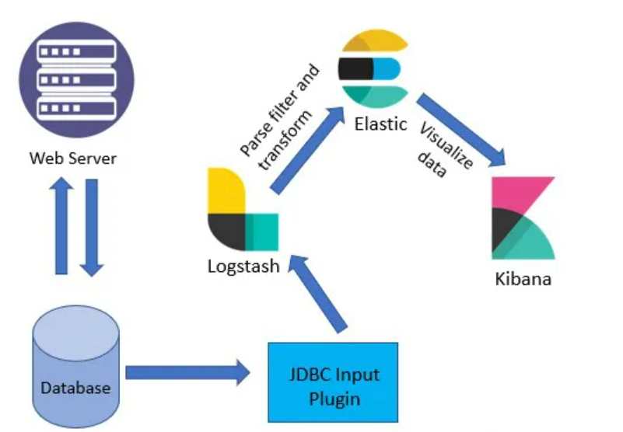
Kibana: Architecture
We have a web server that is connected to a database server for reading and write operations. Then, we are using the JDBC input plugin of Logstash to fetch the data from the database by writing queries. After this, the data is then sent to Elastic, and Kibana uses that data to create the dashboards.

Slide 25
Kibana: Features
Powerful front-end dashboard which is capable of visualizing indexed information from the elastic cluster.
Enables real-time search of indexed information.
You can search, View, and interact with data stored in Elasticsearch.
Execute queries on data & visualize results in charts, tables, and maps.
Configurable dashboard to slice and dice logstash logs in elasticsearch.
Capable of providing historical data in the form of graphs, charts, etc.…
Real-time dashboards which is easily configurable.
Kibana ElasticSearch enables real-time search of indexed information.

Slide 26
Kibana: Features Summed Up
“Enables search and interacts with elastic search”. We could request elastic search RestfulApi’s with dev-tools in Kibana. Besides, Kibana also provides us caching our query syntax, that means, even you close your browser without saving, you could use the caching query syntax at the next time.
“Allows performing advanced analytics and creation of reports”. With Kibana, we could analyze our raw data advanced and discover more data properties which is not focused on by us.
“Enables creation and sharing dynamic dashboards that get updated in real time”. Undoubtedly, this is the most well-known feature in Kibana.

Slide 27
Kibana: How to investigate issues?
Get the trace id. If not available, reproduce the bug/defect in UI and get the traceid by using “Inspect” on your web browser.
Now, since you have the traceid, copy it & login to the Kibana of the environment (Prod/UAT1/UAT2) where the defect had occurred.
After logging into kibana, you should see a search tab. And if you don’t see it, navigate to discover section to see it.
Paste the trace id there, select the time frame for which you want to see the log & click “Update” button.
Logs will appear. To investigate properly, apply filters for “log level = Error”
Select the recent most log box, expand it and scroll to message section, there are high chances this would give you the reason of error.

Slide 28
Kibana: Advantages
Easy visualizing since Kibana is a visualization tool.
Fully integrated with Elasticsearch.
Offers real-time analysis, charting, summarization, and debugging capabilities.
Provides instinctive and user-friendly interface.
Allows sharing of snapshots of the logs searched.
Permits saving the dashboard and managing multiple dashboards.

Slide 29
Kibana: Disadvantages
Sometimes adding third-party plugins to Kibana will be a very tedious job because of version mismatch.
Sometimes not only plugin version issues occur because sometimes when we upgrade then the elasticsearch version also mismatch error occurs.

Slide 30
ELK Stack: Advantages
ELK works best when logs from various Apps of an enterprise converge into a single ELK instance.
It provides amazing insights for this single instance and eliminates the need to log into hundred different log data sources.
Rapid on-premise installation.
Easy to deploy & scales vertically and horizontally.
Elastic offers a host of language clients which includes Ruby, Python, PHP, Perl, .NET, Java, and JavaScript, and more.
Availability of libraries for different programming and scripting languages

Slide 31
ELK Stack: Disadvantages
Different components In the stack can become difficult to handle when you move on to complex setup.
There’s nothing like trial and error. Thus, the more you do, the more you learn along the way

Slide 32
ELK Stack: Summary
Centralized logging can be useful when attempting to identify problems with servers or applications.
ELK server stack is useful to resolve issues related to centralized logging system.
ELK stack is a collection of three open-source tools Elasticsearch, Logstash, Kibana.
Elasticsearch is a NoSQL database, Logstash is the data collection pipeline tool & Kibana is a data visualization which completes the ELK stack.
In cloud-based environment infrastructures, performance and isolation is very important.
In ELK stack processing speed is strictly limited whereas Splunk offers accurate and speedy processes.
Netflix, LinkedIn, Tripwire, Medium all are using ELK stack for their business.
ELK Syslog works best when logs from various Apps of an enterprise converge into a single ELK instance..
Different components In the stack can become difficult to handle when you move on to complex setup

Slide 33


Thank You
- Sanskar Dwivedi Software Developer, SmartOps-CALA
Email: sanskard@amdocs.com

